Slide 1
Top Free Android Games
Kevin Thomas

Slide 2
Goal
To analyze the data of the top free android games and see what makes a game successful.

Slide 3
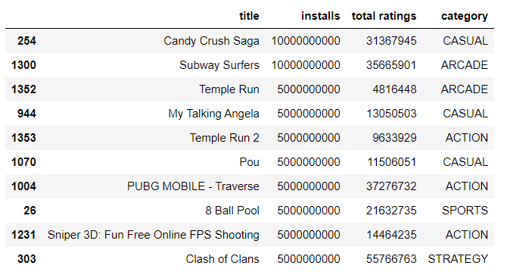
Most Installed Games

Slide 4
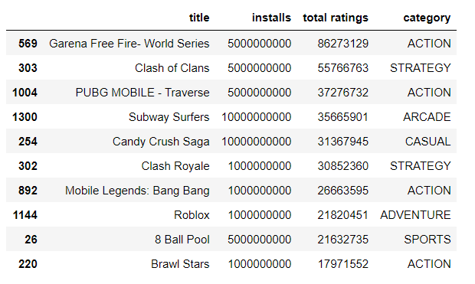
Most Reviewed Games

Slide 5
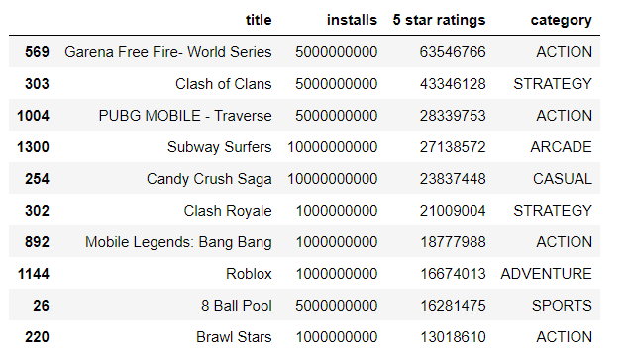
Most 5 star ratings by games

Slide 6
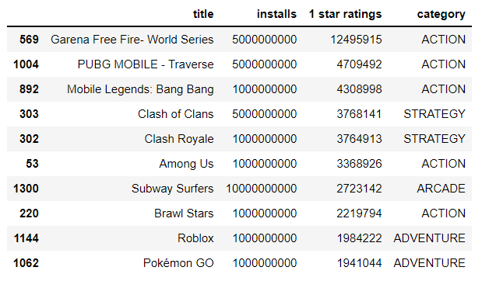
Most 1 Star ratings by games

Slide 7
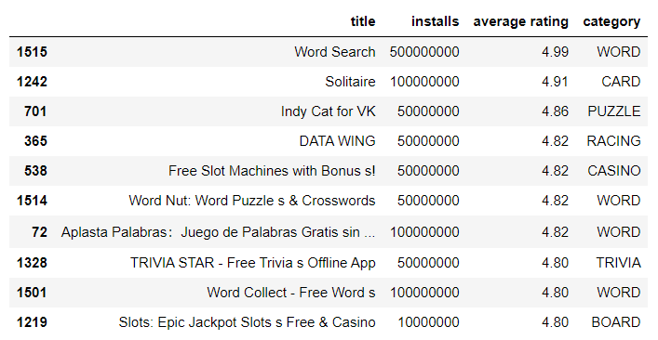
Highest average ratings by games

Slide 8
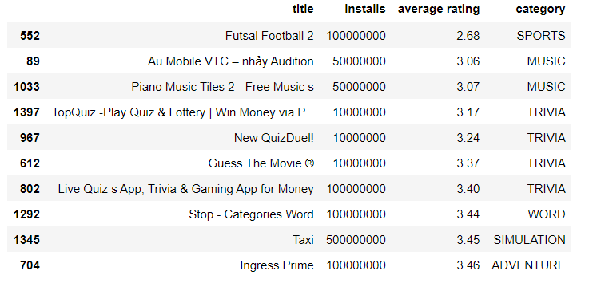
Lowest Average Ratings by Game

Slide 9
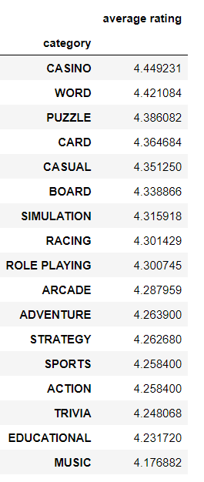
Highest Average rating by category

Slide 10
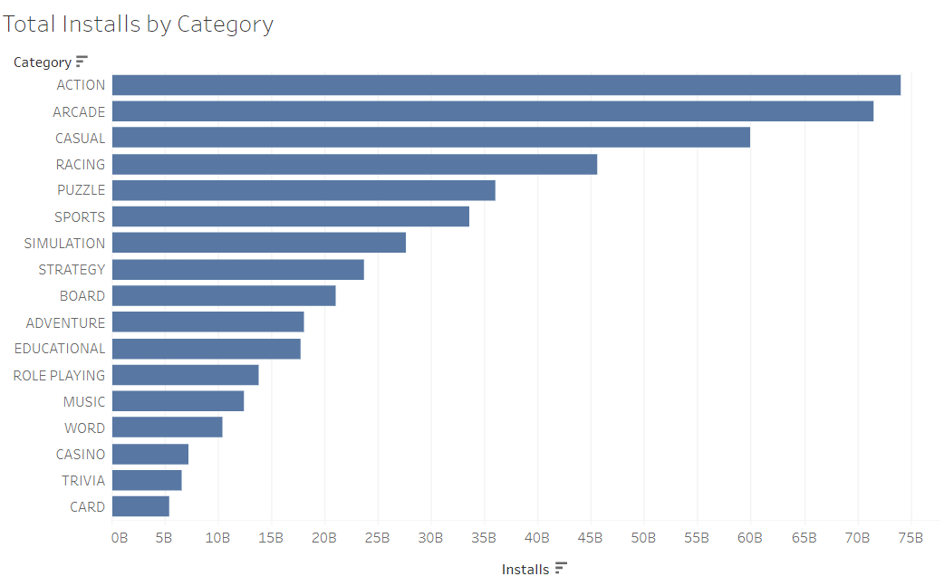

Slide 11
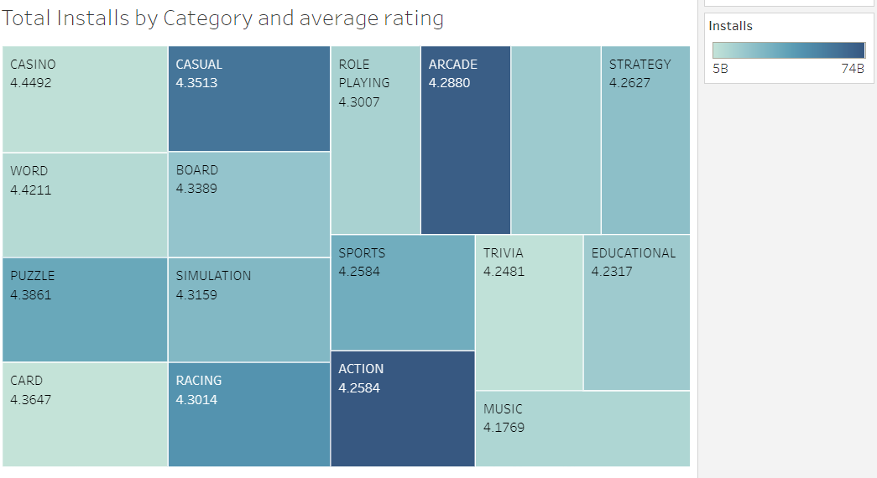

Slide 12
Conclusion
Casual,arcade, and action are the categories that are the most installed and most reviewed
Action and strategy usually get the most 5 star ratings.
Action,adventure and strategy usually get the most 1 star ratings.
Casino and word games have the highest average ratings.
Music,education, and trivia have the lowest average ratings.
In general, the more the game is downloaded, there is more of a mixed opinion.
The less the game is installed, the more likely it had a low rating.

